Slide 1
Unit 2 Searching techniques

Slide 2
Sorting and Searching
Fundamental problems in computer science and programming
Sorting done to make searching easier
Multiple different algorithms to solve the same problem
  How do we know which algorithm is "better"?

Slide 3
Need for Searching & Sorting
There are some very common problems that we use computers to solve:
  Searching through a lot of records for a specific record or set of records
  Placing records in order, which we call sorting
There are numerous algorithms to perform searches and sorts.

Slide 4
Examples of Searching
Finding telephone number in directory
Search a book in library
Searching a particular customer record

Slide 5
Examples of sorting
Sorting Books in Library
Sorting Individuals by Height (Feet and Inches)
Sorting songs(Alphabetical)
Arranging folders in order
Sorting Numbers (Sequential)

Slide 6
Searching
Searching refers to the operation of finding the location of a given item or “not found” in a collection of items.
The search is said to be successful if ITEM does appear in DATA and unsuccessful otherwise.
Examples
1. Sequential Searching
2. Binary Search

Slide 7
Searching Methods

Slide 8
1. Sequential/Linear Search
The array contains the following element
5 7 2 10 15
a[0] a[1] a[2] a[3] a[4]
Now ITEM=2
Algorithm-
1.Give the name to element in the array as a[0] To a[4]
2.Compare each element in the array with ITEM.
3.If ITEM=number
then search is successful.
else
search is unsuccessful.

Slide 9
Three possibilities of finding element in array-
1.A ITEM found in 1st location.
2.A ITEM found in middle location.
3.A ITEM found in last location
Complexity-
1.If ITEM found in 1st location or position
then it is BEST Complexity.
2.If ITEM not found in list
then it is WORST Complexity.
Time Complexity-
This algorithm needs n+1 comparisons where n is the no. of records to be searched.
ie. Time complexity is O(n).

Slide 10
linear search
  start at first item
  is it the one I am looking for?
  if not go to next item
  repeat until found or all items checked
If items not sorted or unsortable this approach is necessary

Slide 11
Linear Search Algorithm
  Set found to false
  Set position to –1
  Set index to 0
  While index < number of elts and found is false
  If list [index] is equal to search value
  found = true
  position = index
  End If
  Add 1 to index
  End While
  Return position

Slide 12
Linear Search Example
Array numlist contains
Searching for the value 11, linear search examines 17, 23, 5, and 11
Searching for the value 7, linear
search examines 17, 23, 5, 11, 2, 29, and 3
17 | 23 | 5 | 11 | 2 | 29 | 3

Slide 13
Efficiency of the Linear Search
The advantage is its simplicity.
  It is easy to understand
  Easy to implement
  Does not require the array to be in order
The disadvantage is its inefficiency
  Inefficient (slow): for array of N elements, examines N/2 elements on average for value that is found in the array, N elements for value that is not in the array
  If there are 20,000 items in the array and what you are looking for is in the 19,999th element, you need to search through the entire list.

Slide 14
int linsearch(S st[],int rollno,int n)
{
int i, comp=0;
for(i=0;i<n ; i++)
{
comp++;
if(rollno==st[i].rollno)
{
cout<<“\nNo. of comparisons = %d ",comp;
return(i);
}
}
cout<<"\nNo. of comparisons” <<comp;
return(-1);
}

Slide 15
2. Binary Search
The binary search is much more efficient than the linear search.
It requires the list to be in order.
The algorithm starts searching with the middle element.
  If the item is less than the middle element, it starts over searching the first half of the list.
  If the item is greater than the middle element, the search starts over starting with the middle element in the second half of the list.
  It then continues halving the list until the item is found.

Slide 16
Binary Search Algorithm
Divide a sorted array into three sections:
  middle element
  elements on one side of the middle element
  elements on the other side of the middle element
If the middle element is the correct value, done. Otherwise, go to step 1, using only the half of the array that may contain the correct value.
Continue steps 1 and 2 until either the value is found or there are no more elements to examine.

Slide 17
Binary Search Example
Array numlist2 contains
Searching for the the value 11, binary search examines 11 and stops
Searching for the the value 7, binary
search examines 11, 3, 5, and stops
2 | 3 | 5 | 11 | 17 | 23 | 29

Slide 18
Binary Search Tradeoffs
Benefit
  Much more efficient than linear search
  (For array of N elements, performs at most
  log₂N comparisons)
Disadvantage
  Requires that array elements be sorted

Slide 19
Write program for binary search with and without recursion.

Slide 20
Sorting Methods

Slide 21
Sorting
Sorting refers to arranging of data elements in some given order.
2 types:
  Internal Sorting
  External Sorting

Slide 22
Internal Sorting
Internal Sorting takes place in the main memory of a computer. The internal sorting methods are applied to small collection of data. It means that, the entire collection of data to be sorted is small enough that the sorting can take place within main memory.

Slide 23
External Sort
The External sorting methods are applied only when the number of data elements to be sorted is too large. These methods involve as much external processing as processing in the CPU.
when sorting is done on data lying on secondary devices then it is called external sorting.
we will normally use this method for sorting elements.

Slide 24
Internal Sort
  The data to be sorted is all stored in the computer’s main memory.
External Sort
  Some of the data to be sorted might be stored in some external, slower, device.

Slide 25
Sort stability
The sorting stability means comparing the records of same value & expecting them in the same order even after sorting them.

Slide 26
Stable sort algorithms
A STABLE sort preserves relative order of records with equal keys
A stable sort keeps equal elements in the same order
This may matter when you are sorting data according to some characteristic
Example: sorting students by test scores
Ann
98
Ann
98
Bob
90
Joe
98
Dan
75
Bob
90
Joe
98
Sam
90
Pat
86
Pat
86
Sam
90
Zöe
86
Zöe
86
Dan
75
original array
stably sorted

Slide 27
Unstable sort algorithms
An unstable sort may or may not keep equal elements in the same order
Stability is usually not important, but sometimes it is important
Ann
98
Joe
98
Bob
90
Ann
98
Dan
75
Bob
90
Joe
98
Sam
90
Pat
86
Zöe
86
Sam
90
Pat
86
Zöe
86
Dan
75
original array
unstably sorted

Slide 28
General concepts:
Sort order:
i.Ascending order
ii.Descending order.

Slide 29
Efficiency:
i. Efficiency of sorting algorithms is denoted in terms of time complexity(i.e. How much time that algorithm have taken to sort elements.)
ii. Time complexities are given in terms of big-oh notations.
iii. Sorting techniques Commonly have O(n²) and O(nlogn)
time complexities.
iv. Bubble, insertion, selection sort have time complexities O(n²).
v. Merge sort & quick sort have complexities O(nlogn)
vi. Where n contains number of records to be sorted.

Slide 30
passes:
While sorting the elements in some order there are lot of arrangements of elements.
The number of times we are visitting the same elements
The phases in which the elements are moving to acquire their proper position is called passes.
Ex.10,30,20,50,40
Pass1:10,20,30,40,50
Pass2:10,20,30,40,50

Slide 31
Sorting Techniques
Bubble sort
Selection sort
Insertion sort
Merge sort
Quick sort
Bucket sort

Slide 32
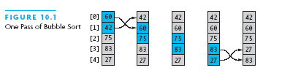
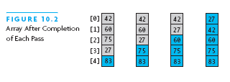
1.Bubble Sort
Compares adjacent array elements and exchanges their values if they are out of order
Smaller values bubble up to the top of the array and larger values sink to the bottom

Slide 33
Bubble sort
This method compares neighboring elements and swapping values at their positions if necessary
Ex.45 -40 190 99 11 sort numbers in ascending order.
For sorting n numbers n-1 passes are needed.
Pass1:-40 45 99 11 190
Pass2:-40 45 11 99 190
Pass3:-40 11 45 99 190
Pass4:-40 11 45 99 190

Slide 34
Analysis of Bubble Sort
Works best when array is nearly sorted to begin with.
Worst case number of comparisons is O(n*n)
Worst case number of exchanges is O(n*n)
Best case occurs when the array is already sorted
  O(n) comparisons

Slide 35
int main()
{
int a[20], i, n;
int ch;
    cout<<“ Enter the number of elements u want to sort";
cin>>n;
cout<<“ Enter the elements for the array \n”;
for(i=0;i<n; i++)
cin>>a[i];
bubblesort(a,n);
return 0;
}

Slide 36
void bubblesort(int a[20], int n)
{
int i ,j ,temp;
for(i=0;i<n-1;i++)
{
for(j=0;j<n-1;j++)
{
if(a[j]>a[j+1])
{
temp=a[j];
a[j]=a[j+1];
a[j+1]=temp;
}
}
}
cout<<“sorted nos. are\n”;
for(i=0;i<n;i++)
cout<<a[i];
}

Slide 37
2. Selection Sort
Selection sort is a relatively easy to understand algorithm
Sorts an array by making several passes through the array, selecting the next smallest item in the array each time and placing it where it belongs in the array
Efficiency is O(n*n)

Slide 38
Given an array of length n,
  Search elements 0 through n-1 and select the smallest
    Swap it with the element in location 0
  Search elements 1 through n-1 and select the smallest
    Swap it with the element in location 1
  Search elements 2 through n-1 and select the smallest
    Swap it with the element in location 2
  Search elements 3 through n-1 and select the smallest
    Swap it with the element in location 3
  Continue in this fashion until there’s nothing left to search

Slide 39
Selection sort
Here element at first position of an array is compared with all the remaining elements.
No. of swappings are reduced.
Ex. 45 -40 190 99 11
Pass1:-40 45 190 99 11
Pass2:-40 11 190 99 45
Pass3:-40 11 45 190 99
Pass4:-40 11 45 99 190
Pass4:-40 11 45 99 190

Slide 40
Selection Sort (continued)
Selection sort is called a quadratic sort
  Number of comparisons is O(n*n)

Slide 41
void selectsort(int a[20],int n)
{
int i ,j ,temp;
for(i=0;i<n-1;i++)
{
for(j=i+1; j<n ; j++)
{
if(a[i]>a[j])
{
temp=a[i];
a[i]=a[j];
a[j]=temp;
}
}
}
cout<<“sorted nos. are\n";
for(i=0;i<n;i++)
cout<<a[i];
}

Slide 42
Selection Sort
int main()
{
int a[20], i, n;
int ch;
cout<<“Enter the number of element in the sorted array";
cin>>n;
cout<<“Enter the elements for the array “;
for(i=0;i<n;i++)
cin>>a[i];
selectsort(a,n);
return 0;
}

Slide 43
Insertion sort:
In this method element’s are inserted at their appropriate places.
Ex. 45 -40 190 99 11

Slide 44
0 1 2 3 4
a 45 -40 190 99 11
b 0 0 0 0 0
Step1:a 45 -40 190 99 11
b 45 0 0 0 0
Step2:a 45 -40 190 99 11
b -40 45 0 0 0
Step3:a 45 -40 190 99 11
b -40 45 190 0 0
Step4:a 45 -40 190 99 11
b -40 45 99 190 0
Step5:a 45 -40 190 99 11
b -40 11 45 99 190

Slide 45
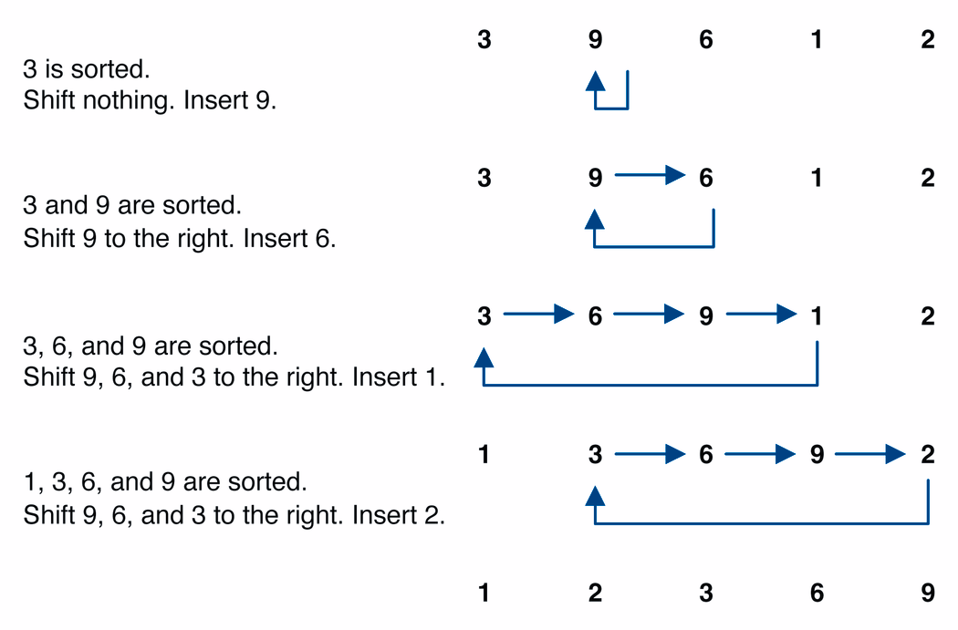
Insertion sort example

Slide 46
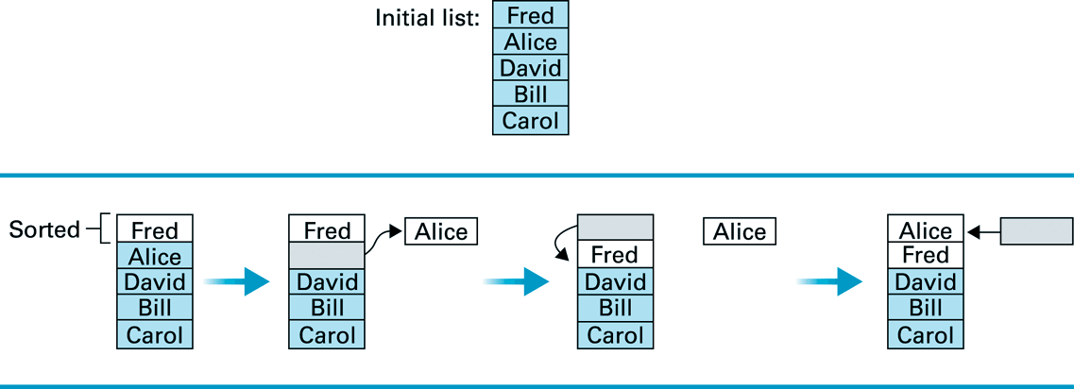
Insertion sort example 2
Names: Fred, Alice, David, Bill, and Carol

Slide 47
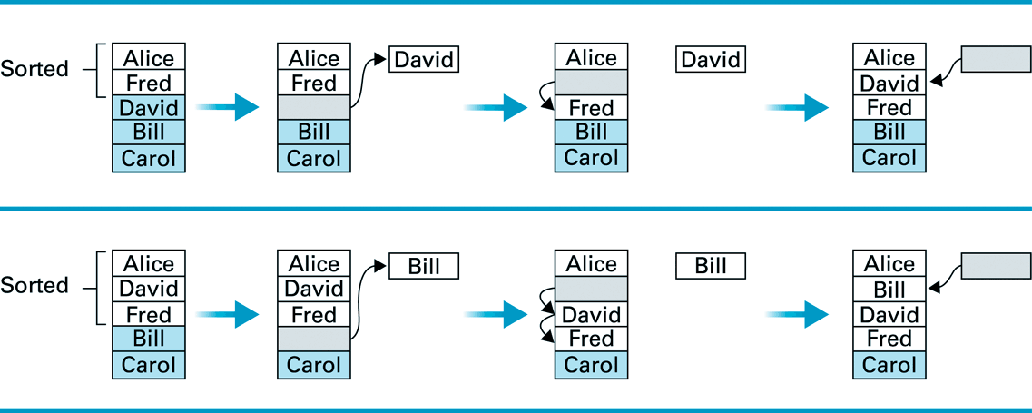
Insertion sort example 2

Slide 48
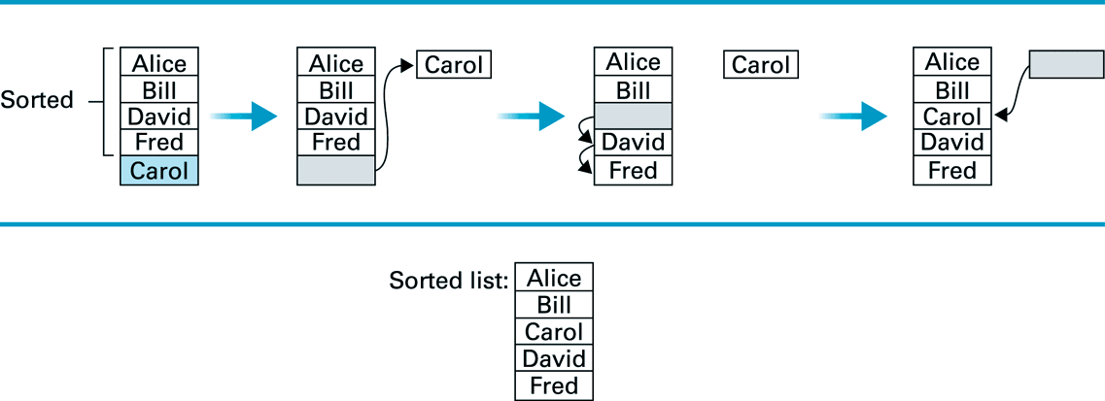
Insertion sort example 2

Slide 49
void insertsort(int a[20],int n)
{
int i ,k ,y;
for(k=1;k<n;k++)
{
y=a[k];
for(i=k-1;i>=0 && y<a[i];i--)
{
a[i+1]=a[i];
a[i]=y;
}
}
cout<<“sorted nos. are\n";
for(i=0;i<n;i++)
cout<<a[i];
}

Slide 50
int main()
{
int a[20],i,n;
int ch;
cout<<“ Enter the number of element in the sorted array";
cin>>n;
cout<<"\n Enter the elements for the array \n";
for(i=0;i<n;i++)
cin>>a[i];
insertsort(a,n);
return 0;
}

Slide 51
Merge sort
merge sort: This method divides the list in half until each sub-list has one element, then recombining
more specifically:
  divide the list into two roughly equal parts
  recursively divide each part in half, continuing until a part contains only one element
  merge the two parts into one sorted list
  continue to merge parts as the recursion unfolds
This is a "divide and conquer" algorithm.

Slide 52
Merge sort
Merge sort idea:
  Divide the array into two halves.
  Recursively sort the two halves (using merge sort).
  Use merge to combine the two arrays.
mergeSort(0, n/2-1)
mergeSort(n/2, n-1)
sort
sort
merge(0, n/2, n-1)

Slide 53
98
23
45
14
6
67
33
42

Slide 54
98
23
45
14
6
67
33
42
98
23
45
14
6
67
33
42

Slide 55
98
23
45
14
6
67
33
42
98
23
45
14
6
67
33
42
98
23
45
14

Slide 56
98
23
45
14
6
67
33
42
98
23
45
14
6
67
33
42
98
23
45
14
98
23

Slide 57
98
23
45
14
6
67
33
42
98
23
45
14
6
67
33
42
98
23
45
14
98
23
Merge

Slide 58
98
23
45
14
6
67
33
42
98
23
45
14
6
67
33
42
98
23
45
14
98
23
23
Merge

Slide 59
98
23
45
14
6
67
33
42
98
23
45
14
6
67
33
42
98
23
45
14
98
23
23
98
Merge

Slide 60
98
23
45
14
6
67
33
42
98
23
45
14
6
67
33
42
98
23
45
14
98
23
45
14
23
98

Slide 61
98
23
45
14
6
67
33
42
98
23
45
14
6
67
33
42
98
23
45
14
98
23
45
14
23
98
Merge

Slide 62
98
23
45
14
6
67
33
42
98
23
45
14
6
67
33
42
98
23
45
14
98
23
45
14
23
98
14
Merge

Slide 63
98
23
45
14
6
67
33
42
98
23
45
14
6
67
33
42
98
23
45
14
98
23
45
14
23
98
14
45
Merge

Slide 64
98
23
45
14
6
67
33
42
98
23
45
14
6
67
33
42
98
23
45
14
98
23
45
14
23
98
14
45
Merge

Slide 65
98
23
45
14
6
67
33
42
98
23
45
14
6
67
33
42
98
23
45
14
98
23
45
14
23
98
14
45
14
Merge

Slide 66
98
23
45
14
6
67
33
42
98
23
45
14
6
67
33
42
98
23
45
14
98
23
45
14
23
98
14
45
14
23
Merge

Slide 67
98
23
45
14
6
67
33
42
98
23
45
14
6
67
33
42
98
23
45
14
98
23
45
14
23
98
14
45
14
23
45
Merge

Slide 68
98
23
45
14
6
67
33
42
98
23
45
14
6
67
33
42
98
23
45
14
98
23
45
14
23
98
14
45
14
23
45
98
Merge

Slide 69
98
23
45
14
6
67
33
42
98
23
45
14
6
67
33
42
98
23
45
14
6
67
33
42
98
23
45
14
23
98
14
45
14
23
45
98

Slide 70
98
23
45
14
6
67
33
42
98
23
45
14
6
67
33
42
98
23
45
14
6
67
33
42
98
23
45
14
6
67
23
98
14
45
14
23
45
98

Slide 71
98
23
45
14
6
67
33
42
98
23
45
14
6
67
33
42
98
23
45
14
6
67
33
42
98
23
45
14
6
67
23
98
14
45
14
23
45
98
Merge

Slide 72
98
23
45
14
6
67
33
42
98
23
45
14
6
67
33
42
98
23
45
14
6
67
33
42
98
23
45
14
6
67
23
98
14
45
6
14
23
45
98
Merge

Slide 73
98
23
45
14
6
67
33
42
98
23
45
14
6
67
33
42
98
23
45
14
6
67
33
42
98
23
45
14
6
67
23
98
14
45
6
67
14
23
45
98
Merge

Slide 74
98
23
45
14
6
67
33
42
98
23
45
14
6
67
33
42
98
23
45
14
6
67
33
42
98
23
45
14
6
67
33
42
23
98
14
45
6
67
14
23
45
98

Slide 75
98
23
45
14
6
67
33
42
98
23
45
14
6
67
33
42
98
23
45
14
6
67
33
42
98
23
45
14
6
67
33
42
23
98
14
45
6
67
14
23
45
98
Merge

Slide 76
98
23
45
14
6
67
33
42
98
23
45
14
6
67
33
42
98
23
45
14
6
67
33
42
98
23
45
14
6
67
33
42
23
98
14
45
6
67
33
14
23
45
98
Merge

Slide 77
98
23
45
14
6
67
33
42
98
23
45
14
6
67
33
42
98
23
45
14
6
67
33
42
98
23
45
14
6
67
33
42
23
98
14
45
6
67
33
42
14
23
45
98
Merge

Slide 78
98
23
45
14
6
67
33
42
98
23
45
14
6
67
33
42
98
23
45
14
6
67
33
42
98
23
45
14
6
67
33
42
23
98
14
45
6
67
33
42
14
23
45
98
Merge

Slide 79
98
23
45
14
6
67
33
42
98
23
45
14
6
67
33
42
98
23
45
14
6
67
33
42
98
23
45
14
6
67
33
42
23
98
14
45
6
67
33
42
14
23
45
98
6
Merge

Slide 80
98
23
45
14
6
67
33
42
98
23
45
14
6
67
33
42
98
23
45
14
6
67
33
42
98
23
45
14
6
67
33
42
23
98
14
45
6
67
33
42
14
23
45
98
6
33
Merge

Slide 81
98
23
45
14
6
67
33
42
98
23
45
14
6
67
33
42
98
23
45
14
6
67
33
42
98
23
45
14
6
67
33
42
23
98
14
45
6
67
33
42
14
23
45
98
6
33
42
Merge

Slide 82
98
23
45
14
6
67
33
42
98
23
45
14
6
67
33
42
98
23
45
14
6
67
33
42
98
23
45
14
6
67
33
42
23
98
14
45
6
67
33
42
14
23
45
98
6
33
42
67
Merge

Slide 83
98
23
45
14
6
67
33
42
98
23
45
14
6
67
33
42
98
23
45
14
6
67
33
42
98
23
45
14
6
67
33
42
23
98
14
45
6
67
33
42
14
23
45
98
6
33
42
67
Merge

Slide 84
98
23
45
14
6
67
33
42
98
23
45
14
6
67
33
42
98
23
45
14
6
67
33
42
98
23
45
14
6
67
33
42
23
98
14
45
6
67
33
42
14
23
45
98
6
33
42
67
6
Merge

Slide 85
98
23
45
14
6
67
33
42
98
23
45
14
6
67
33
42
98
23
45
14
6
67
33
42
98
23
45
14
6
67
33
42
23
98
14
45
6
67
33
42
14
23
45
98
6
33
42
67
6
14
Merge

Slide 86
98
23
45
14
6
67
33
42
98
23
45
14
6
67
33
42
98
23
45
14
6
67
33
42
98
23
45
14
6
67
33
42
23
98
14
45
6
67
33
42
14
23
45
98
6
33
42
67
6
14
23
Merge

Slide 87
98
23
45
14
6
67
33
42
98
23
45
14
6
67
33
42
98
23
45
14
6
67
33
42
98
23
45
14
6
67
33
42
23
98
14
45
6
67
33
42
14
23
45
98
6
33
42
67
6
14
23
33
Merge

Slide 88
98
23
45
14
6
67
33
42
98
23
45
14
6
67
33
42
98
23
45
14
6
67
33
42
98
23
45
14
6
67
33
42
23
98
14
45
6
67
33
42
14
23
45
98
6
33
42
67
6
14
23
33
42
Merge

Slide 89
98
23
45
14
6
67
33
42
98
23
45
14
6
67
33
42
98
23
45
14
6
67
33
42
98
23
45
14
6
67
33
42
23
98
14
45
6
67
33
42
14
23
45
98
6
33
42
67
6
14
23
33
42
45
Merge

Slide 90
98
23
45
14
6
67
33
42
98
23
45
14
6
67
33
42
98
23
45
14
6
67
33
42
98
23
45
14
6
67
33
42
23
98
14
45
6
67
33
42
14
23
45
98
6
33
42
67
6
14
23
33
42
45
67
Merge

Slide 91
98
23
45
14
6
67
33
42
98
23
45
14
6
67
33
42
98
23
45
14
6
67
33
42
98
23
45
14
6
67
33
42
23
98
14
45
6
67
33
42
14
23
45
98
6
33
42
67
6
14
23
33
42
45
67
98
Merge

Slide 92
98
23
45
14
6
67
33
42
98
23
45
14
6
67
33
42
98
23
45
14
6
67
33
42
98
23
45
14
6
67
33
42
23
98
14
45
6
67
33
42
14
23
45
98
6
33
42
67
6
14
23
33
42
45
67
98

Slide 93
98
23
45
14
6
67
33
42
6
14
23
33
42
45
67
98

Slide 94
Merge sort example 2
13 | 6 | 21 | 18 | 9 | 4 | 8 | 20
0 |  |  |  |  |  |  | 7
13 | 6 | 21 | 18
0 |  |  | 3
9 | 4 | 8 | 20
4 |  |  | 7
13 | 6
0 | 1
21 | 18
2 | 3
9 | 4
4 | 5
8 | 20
6 | 7
13
0
6
1
21
2
18
3
9
4
4
5
8
6
20
7
6 | 13
0 | 1
18 | 21
2 | 3
4 | 9
4 | 5
8 | 20
6 | 7
6 | 13 | 18 | 21
0 |  |  | 3
4 | 8 | 9 | 20
4 |  |  | 7
4 | 6 | 8 | 9 | 13 | 18 | 20 | 21
0 |  |  |  |  |  |  | 7

Slide 95
Quick sort
quick sort: orders a list of values by partitioning the list around one element called a pivot, then sorting each partition
more specifically:
  choose one element in the list to be the pivot (= partition element)
  organize the elements so that all elements less than the pivot are to its left and all greater are to its right
  apply the quick sort algorithm (recursively) to both partitions

Slide 96
Quick sort illustrated
pick a pivot
40
37
2
18
32
6
35
10
12
17
partition
6
17
40
37
10
12
2
18
32
35
quicksort
quicksort
2
6
10
12
17
18
32
35
37
40
combine
2
6
10
12
17
18
32
35
37
40

Slide 97
Quick Sort
0 | 1 | 2 | 3 | 4 | 5 | 6 | 7
25 | 57 | 48 | 38 | 10 | 91 | 84 | 33
Step 1- Set a[0] ^{th} element ie 25 as pivot element .The index 0 of array a is lower bound and the index 7 is the upper bound
Lb
ub
0 | 1 | 2 | 3 | 4 | 5 | 6 | 7
25 | 57 | 48 | 38 | 10 | 91 | 84 | 33
25
pivot

Slide 98
Now find all the element lesser than 25 and place 25 after all the lesser elements.
10 25
sublist1 pivot
Step2:
As in sub-list 1 only 1 element is present no need to sort it. But the sub-list2 can be sorted.
For that purpose set new pivot element as 57.find all the lesser than 57 element & place them before 57.
57 | 48 | 38 | 91 | 84 | 33
0 | 1 | 2 | 3 | 4 | 5 | 6 | 7
10 | 25 | 48 | 38 | 33 | 57 | 91 | 84
48 38 33
57
91 84
sublist1 pivot sublist2

Slide 99
Step 3:
As again from sublist1 & sublist2 sort the element take sublist1, 48 is new pivot element place all lesser than 48 element before it.
Step 4
0 | 1 | 2 | 3 | 4 | 5 | 6 | 7
10 | 25 | 38 | 33 |  | 57 | 84 | 91
48
91
pivot
pivot
0 | 1 | 2 | 3 | 4 | 5 | 6 | 7
10 | 25 |  | 33 | 48 | 57 | 84 | 91
38
33
Pivot sublist 1

Slide 100
Sorted list
0 | 1 | 2 | 3 | 4 | 5 | 6 | 7
10 | 25 | 33 | 38 | 48 | 57 | 84 | 91

Slide 101
Analysis of sorting Techniques:
Sorting Technique Time Complexity cases)
Average Best Worst
Bubble sort n² n² n²
Selection sort n² n² n²
Insertion sort n² n² n²
Merge sort <=n <=n <=n
Quick sort nlogn nlogn n²

Slide 102
Divide-and-Conquer
Divide and Conquer is a method of algorithm design.
This method has three distinct steps:
  Divide: If the input size is too large to deal with in a straightforward manner, divide the data into two or more disjoint subsets.
  Recurse: Use divide and conquer to solve the subproblems associated with the data subsets.
  Conquer: Take the solutions to the subproblems and “merge” these solutions into a solution for the original problem.

Slide 103
4. Quick-Sort
1) Divide : If the sequence S has 2 or more elements, select an element x from S to be your pivot. Any arbitrary element, like the last, will do. Remove all the elements of S and divide them into 3 sequences:
  L, holds S’s elements less than x
  E, holds S’s elements equal to x
  G, holds S’s elements greater than x
2) Recurse: Recursively sort L and G
3) Conquer: Finally, to put elements back into S in order, first inserts the elements of L, then those of E, and those of G.

Slide 104
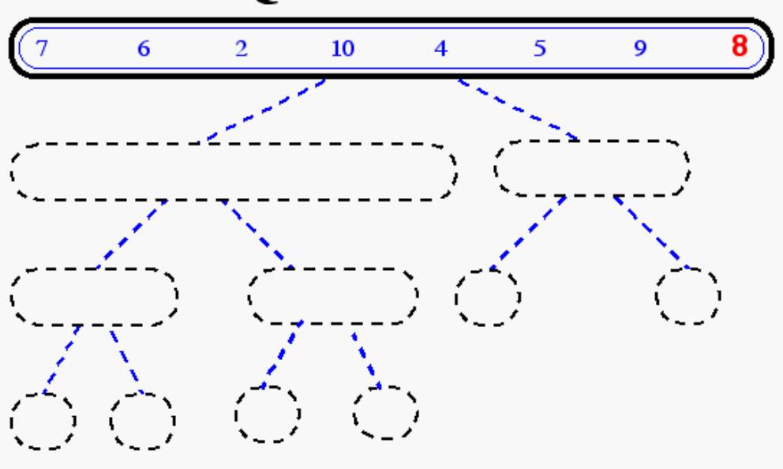
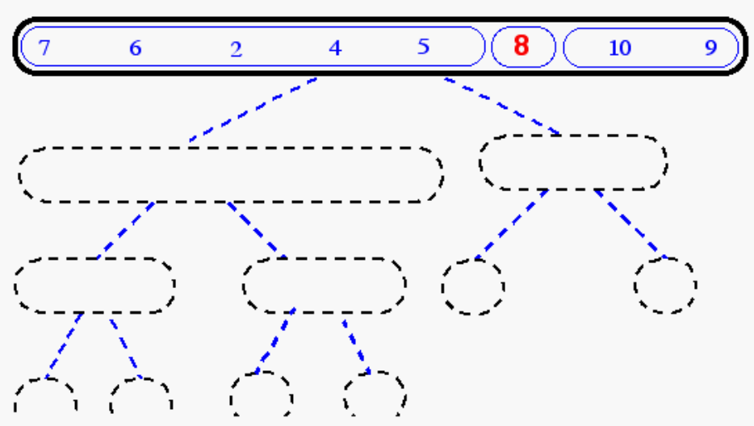
Quick-Sort Tree

Slide 105
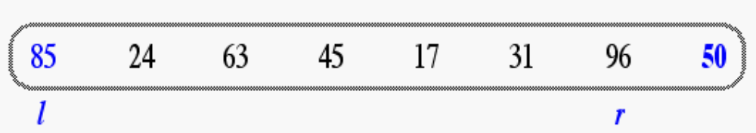
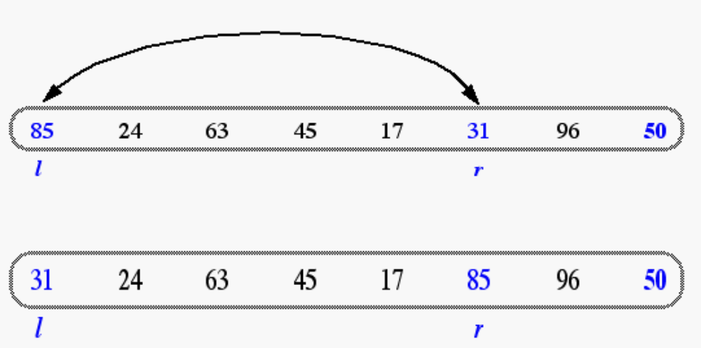
In-Place Quick-Sort
Divide step: l scans the sequence from the left, and r from the right.
A swap is performed when l is at an element larger than the pivot and r is at one smaller than the pivot.

Slide 106
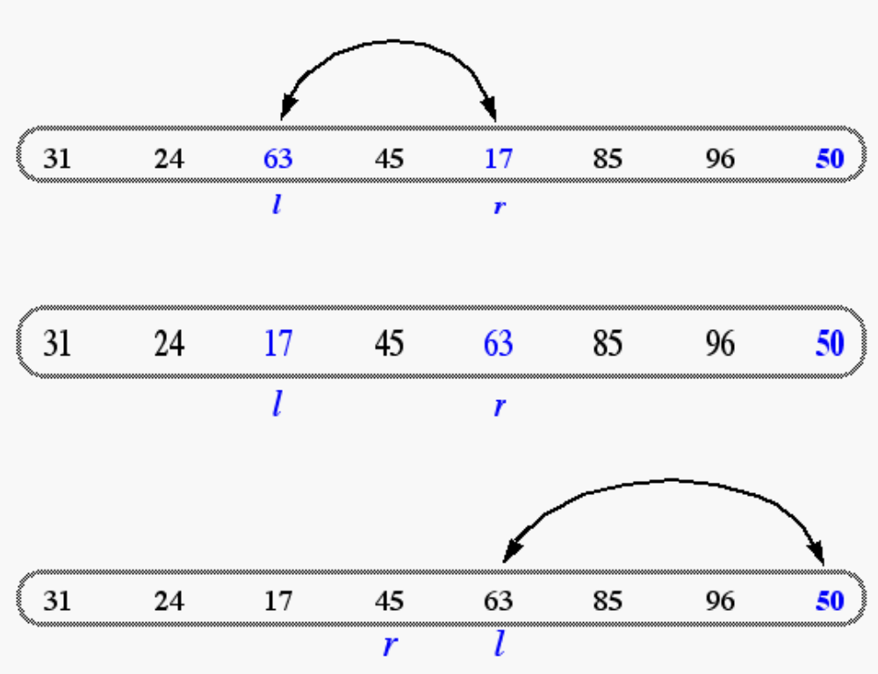
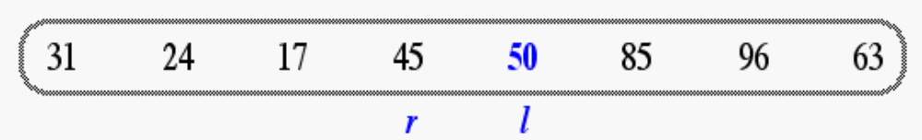
In Place Quick Sort (cont’d)
A final swap with the pivot completes the divide step

Slide 107
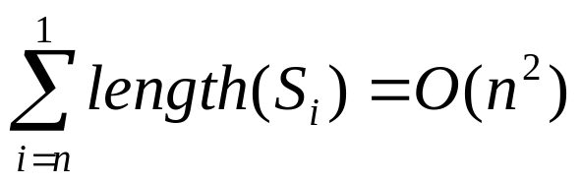
Quick Sort Running Time
Worst case: when the pivot does not divide the sequence in two
At each step, the length of the sequence is only reduced by 1
Total running time
General case:
  Time spent at level i in the tree is O(n)
  Running time: O(n) * O(height)
Average case:
  O(n log n)

Slide 108
5. Merge-Sort
Algorithm:
  Divide: If S has at least two elements (nothing needs to be done if S has zero or one elements), remove all the elements from S and put them into two sequences, S₁ and S₂, each containing about half of the elements of S. (i.e. S₁ contains the first ⎡n/2⎤ elements and S₂ contains the remaining ⎣n/2⎦ elements.
  Recur: Recursive sort sequences S₁ and S₂.
  Conquer: Put back the elements into S by merging the sorted sequences S₁ and S₂ into a unique sorted sequence.

Slide 109
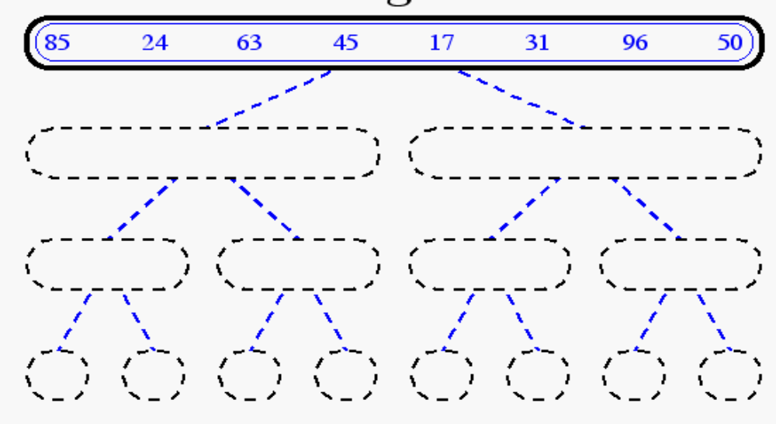
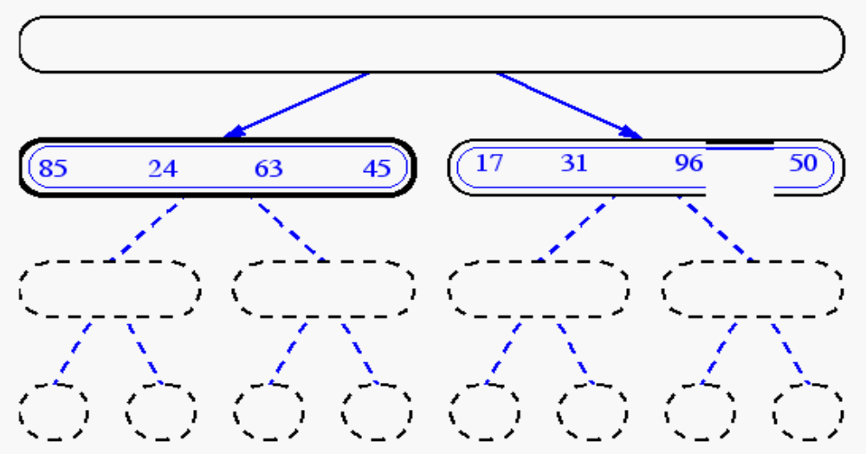
Merge-Sort Example

Slide 110
Divide and Conquer
Base case: the problem is small enough, solve directly
Divide the problem into two or more similar and smaller subproblems
Recursively solve the subproblems
Combine solutions to the subproblems

Slide 111
Divide and Conquer - Sort
Base case
  single element (n=1), return
Divide A into two subarrays: FirstPart, SecondPart
    Two Subproblems:
      sort the FirstPart
      sort the SecondPart
Recursively
      sort FirstPart
      sort SecondPart
Combine sorted FirstPart and sorted second part

Slide 112
Merge Sort: Idea
Divide into
two halves
A:
FirstPart
SecondPart
Recursively sort
FirstPart
SecondPart
Merge
A is sorted!

Slide 113
Merge Sort: Algorithm
Merge-Sort (A, n)
if n=1 return
else
n₁ ← n₂ ← n/2
create array L[n₁], R[n₂]
for i ← 0 to n₁-1 do L[i] ← A[i]
for j ← 0 to n₂-1 do R[j] ← A[n₁+j]
  Merge-Sort(L, n₁)
  Merge-Sort(R, n₂)
  Merge(A, L, n₁, R, n₂ )
Space: n
Time: n
Recursive Call

Slide 114
Merge-Sort: Merge
Sorted
A:
merge
Sorted
Sorted
L:
R:

Slide 115
Merge-Sort: Merge Example
A:
L:
1
2
6
8
R:
3
4
5
7

Slide 116
Merge-Sort: Merge Example
A:
3
1
5
15
28
10
14
k=0
L:
R:
3
1
15
2
28
6
30
8
6
3
10
4
14
5
22
7
i=0
j=0

Slide 117
Merge-Sort: Merge Example
A:
1
2
5
15
28
30
6
10
14
k=1
L:
R:
3
1
5
2
15
6
28
8
6
3
10
4
14
5
22
7
i=1
j=0

Slide 118
Merge-Sort: Merge Example
A:
1
2
3
15
28
30
6
10
14
k=2
L:
R:
1
2
6
8
6
3
10
4
14
5
22
7
i=2
j=0

Slide 119
Merge-Sort: Merge Example
A:
1
2
3
4
6
10
14
k=3
L:
R:
1
2
6
8
6
3
10
4
14
5
22
7
i=2
j=1

Slide 120
Merge-Sort: Merge Example
A:
1
2
3
4
5
6
10
14
k=4
L:
R:
1
2
6
8
6
3
10
4
14
5
22
7
i=2
j=2

Slide 121
Merge-Sort: Merge Example
A:
1
2
3
4
5
6
6
10
14
k=5
L:
R:
1
2
6
8
6
3
10
4
14
5
22
7
i=2
j=3

Slide 122
Merge-Sort: Merge Example
A:
1
2
3
4
5
6
7
14
k=6
L:
R:
1
2
6
8
6
3
10
4
14
5
22
7
i=3
j=3

Slide 123
Merge-Sort: Merge Example
A:
1
2
3
4
5
5
7
8
14
k=7
L:
R:
3
1
5
2
15
6
28
8
6
3
10
4
14
5
22
7
i=3
j=4

Slide 124
Merge-Sort: Merge Example
A:
1
2
3
4
5
6
7
8
k=8
L:
R:
3
1
5
2
15
6
28
8
6
3
10
4
14
5
22
7
i=4
j=4

Slide 125
merge(A,L,n₁,R,n₂)
i ← j ← 0
for k ← 0 to n₁+n₂-1
if i < n₁
if j = n₂ or L[i] ≤ R[j]
A[k] ← L[i]
i ← i + 1
else
if j < n₂
A[k] ← R[j]
j ← j + 1
Number of iterations: (n₁+n₂)
Total time: c(n₁+n₂) for some c

Slide 126
Merge-Sort Execution Example
Divide
6 2 8 4
3 7 5 1
6 2 8 4 3 7 5 1

Slide 127
Merge-Sort Execution Example
Recursive call
, divide
3 7 5 1
6 2
8 4
6 2 8 4

Slide 128
Merge-Sort Execution Example
Recursive call
, divide
3 7 5 1
8 4
6
2
6 2

Slide 129
Merge-Sort Execution Example
Recursive call
, base case
3 7 5 1
8 4
2
6

Slide 130
Merge-Sort Execution Example
Recursive call return
3 7 5 1
8 4
6
2

Slide 131
Merge-Sort Execution Example
Recursive call
, base case
3 7 5 1
8 4
6
2

Slide 132
Merge-Sort Execution Example
Recursive call return
3 7 5 1
8 4
6
2

Slide 133
Merge-Sort Execution Example
Merge
3 7 5 1
8 4
2 6

Slide 134
Merge-Sort Execution Example
Recursive call return
3 7 5 1
2 6
8 4

Slide 135
Merge-Sort Execution Example
Recursive call
, divide
3 7 5 1
2 6
8
4
8 4

Slide 136
Merge-Sort Execution Example
Recursive call, base case
3 7 5 1
2 6
4
8

Slide 137
Merge-Sort Execution Example
Recursive call return
3 7 5 1
2 6
8
4

Slide 138
Merge-Sort Execution Example
Recursive call, base case
2 6
8
4

Slide 139
Merge-Sort Execution Example
Recursive call return
3 7 5 1
2 6
8
4

Slide 140
Merge-Sort Execution Example
merge
3 7 5 1
2 6
4 8

Slide 141
Merge-Sort Execution Example
Recursive call return
3 7 5 1
2 6
4 8

Slide 142
Merge-Sort Execution Example
merge
3 7 5 1
2 4 6 8

Slide 143
Merge-Sort Execution Example
Recursive call return
2 4 6 8
3 7 5 1

Slide 144
Merge-Sort Execution Example
Recursive call
2 4 6 8
3 7 5 1

Slide 145
Merge-Sort Execution Example
2 4 6 8
1 3 5 7

Slide 146
Merge-Sort Execution Example
Recursive call return
2 4 6 8
1 3 5 7

Slide 147
Merge-Sort Execution Example
merge
1 2 3 4 5 6 7 8

Slide 148
Merge-Sort Analysis
Time, divide
n
n
n/2
n/2
2 × n/2 = n
log n levels
n/4
n/4
n/4
n/4
4 × n/4 = n
n/2 × 2 = n
Total time for divide: n log n

Slide 149
Merge-Sort Analysis
Time, merging
n
cn
n/2
n/2
2 × cn/2 = n
log n levels
n/4
n/4
n/4
n/4
4 × cn/4 = n
n/2 × 2c = n
Total time for merging: cn log n
Total running time: order of nlogn
Total Space: order of n

Slide 150
Running Time of Merge-Sort
At each level in the binary tree created for Merge Sort, there are n elements, with O(1) time spent at each element
  → O(n) running time for processing one level
The height of the tree is O(log n)
Therefore, the time complexity is O(nlog n)

Slide 151
Big-Oh to Primary Sorts
Bubble Sort = n²
Selection Sort = n²
Insertion Sort = n²
Merge Sort = n log(n)
Quick Sort = n log(n)

